Slide 1


RETAIL SALES FORECASTING AND PROMOTION EFFECTIVENESS
ASSIGNMENT 3
Presented by:
Krishna P
TOOLS: PYTHON | PANDAS | SCIKIT-LEARN | JUPYTER NOTEBOOK

Slide 2
Introduction
  Retail sales vary based on previous demand, price, promotions, products, and stores.
  Accurate forecasting helps businesses improve inventory and sales planning.
  This project focuses on weekly product-store sales forecasting.
  Historical transaction, product, and store data were combined forward analysis.
  A Random Forest model was developed and compared with a Naive Forecast.
  A 13-week time-based holdout was used for evaluation.

Slide 3


Objectives
  Analyze the quality and characteristics of retail sales data.
  Combine transaction, product, and store information.
  Create a product-store level forecasting dataset.
  Use historical sales, price, and promotion features for forecasting.
  Compare Naive Forecast and Random Forest models.
  Evaluate performance using a 13-week time-based holdout.
  Analyze the impact of price and promotions on demand.
  Perform a price scenario analysis.
  Provide business recommendations based on the results.
3

Slide 4
Dataset & Data Preparation
  Dataset: Dunnhumby – Breakfast at the Frat
  524,950 transaction records
  156 weekly periods
  3 main data sources:
Transaction Data, Products Lookup, Store Lookup
  Product and store information were joined with transaction data.
  Data quality checks were performed for:
  Missing values
  Duplicate records
  Invalid prices
  Product/store mappings
  Final forecasting level: Product × Store × Week
4

Slide 5
Methodology & Feature Engineering
EDA & Data Quality
  Checked missing values in important variables.
  Identified zero-sales and zero-price observations.
  Checked for duplicate transaction records.
  Verified product and store mappings.
  Analyzed product-store coverage across 156 weeks.
  Identified variations in sales across products and stores.
  Final dataset contained 3,909 product-store combinations.
  Created product-store-week forecasting dataset.
  Used time-based train-test split.
  Training period: 143 weeks
  Testing period: 13 weeks
  Created historical demand features:
  Lag 1, 2, 3, 4 & 8
  4-week & 8-week rolling averages
  Added price and discount features.
  Added promotion features:
  Feature
  Display
  TPR
  Added product, store and calendar features.
5

Slide 6
Forecasting Models
1. Naive Forecast
  Uses the previous week's sales as the forecast.
  Used as the baseline model.
2. Random Forest Regression
  Uses historical sales, price, promotion, product, and store features.
  200 trees
  Maximum depth: 12
  Minimum samples per leaf: 2
Time-Based Validation
  Training: 143 weeks
  Holdout: 13 weeks
  Evaluation based on MAE, RMSE and MAPE.
6

Slide 7
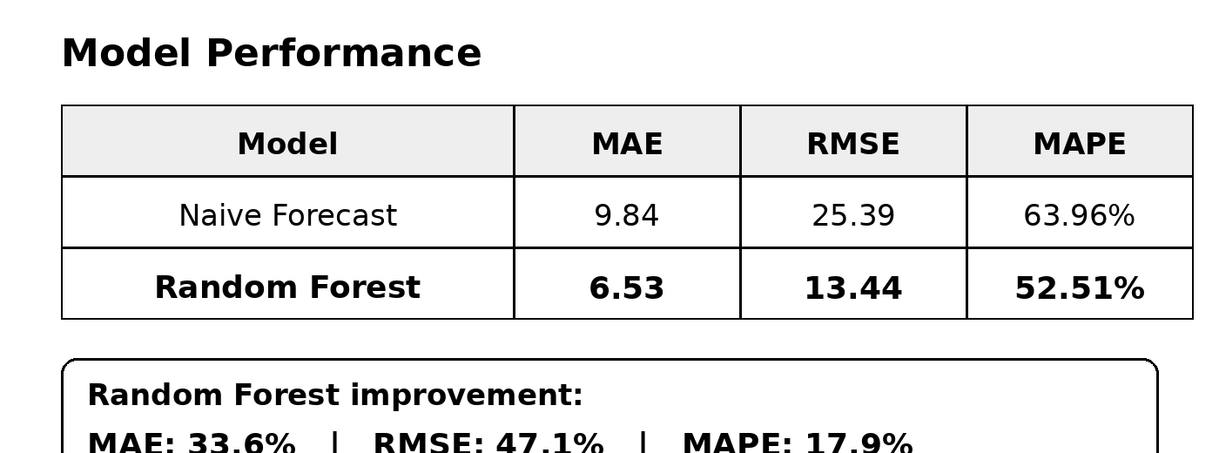
Model Performance
Key Result
Random Forest outperformed the Naive Forecast.
MAE improved by 33.6%
RMSE improved by 47.1%
MAPE improved by 17.9%
7

Slide 8
Price Scenario Analysis
A 10% price reduction scenario was tested.
Baseline predicted demand: 23.14 units
Predicted demand after price reduction: 26.45 units
Demand increase: 3.31 units
Estimated demand increase: 13.75%
The scenario shows how the model can support pricing decisions.
8

Slide 9
Key Findings & Recommendations
Key Findings
  Random Forest performed better than the Naive Forecast.
  Recent sales history was the strongest demand predictor.
  Price and promotion information improved forecasting accuracy.
  A 10% price reduction resulted in 13.75% higher predicted demand.
Recommendations
  Use recent sales trends for inventory planning.
  Include promotions in demand forecasting.
  Use scenario analysis to support pricing decisions.
  Forecast at product-store level for better planning.
9

Slide 10
Conclusion
  Developed a product-store level retail sales forecasting system.
  Used historical sales, price, promotion, product, and store information.
  Random Forest achieved better performance than the Naive Forecast.
  The model improved demand prediction for the 13-week holdout period.
  Price scenario analysis showed potential demand improvement under a 10% price reduction.
  The project can support inventory planning, pricing, and promotional decisions.
10

Slide 11
Thank you!
KRISHNA P
RA2311042010017

